Slide 1
Radio Fingerprint Recognition with Machine Learning
2019-10-15

Slide 2
Purpose
Extracting analog features from Wi-Fi signal for device identification or recognition with Machine Learning method

Slide 3

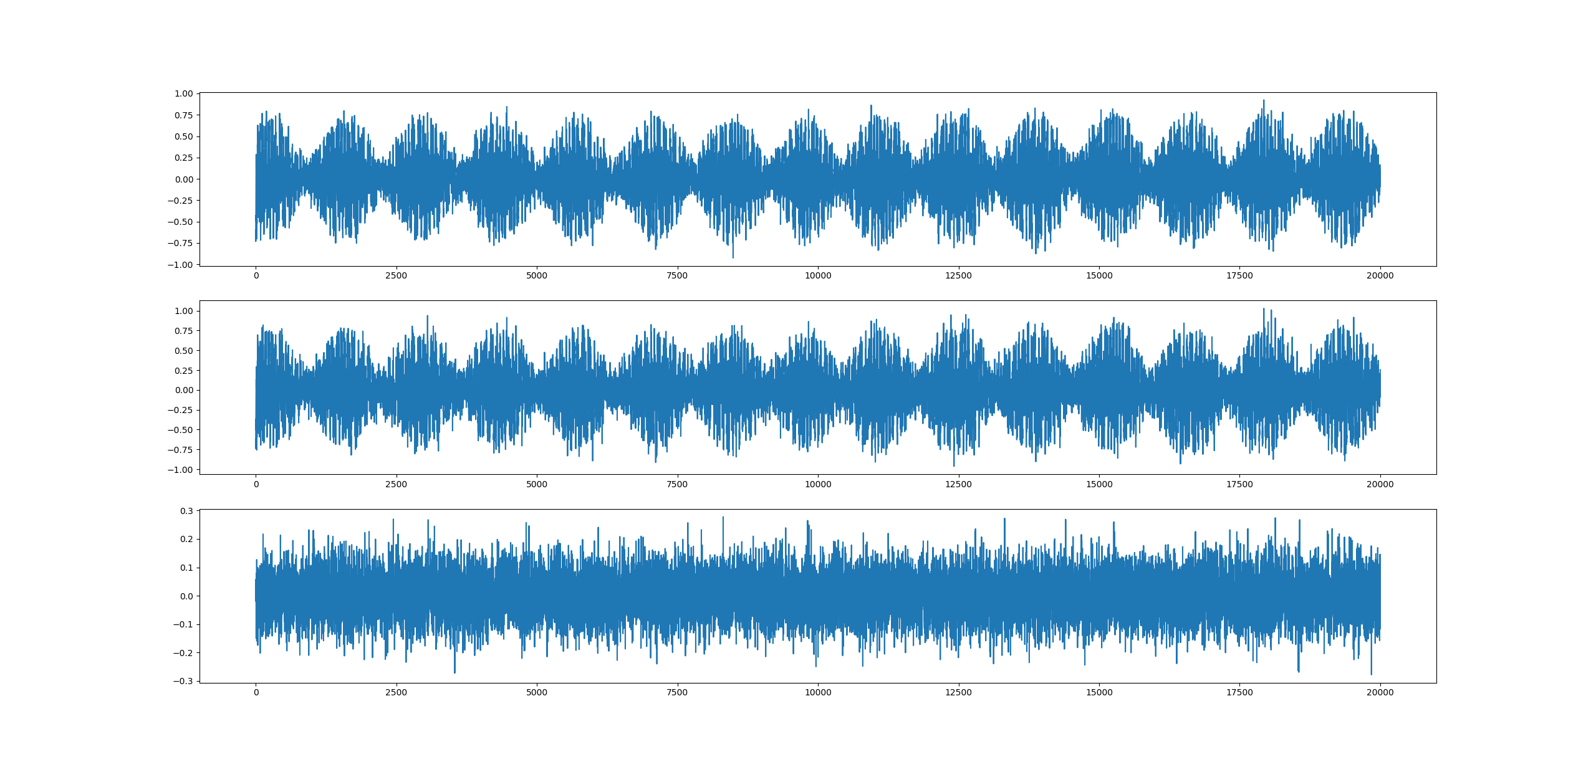
Data Collection

Slide 4
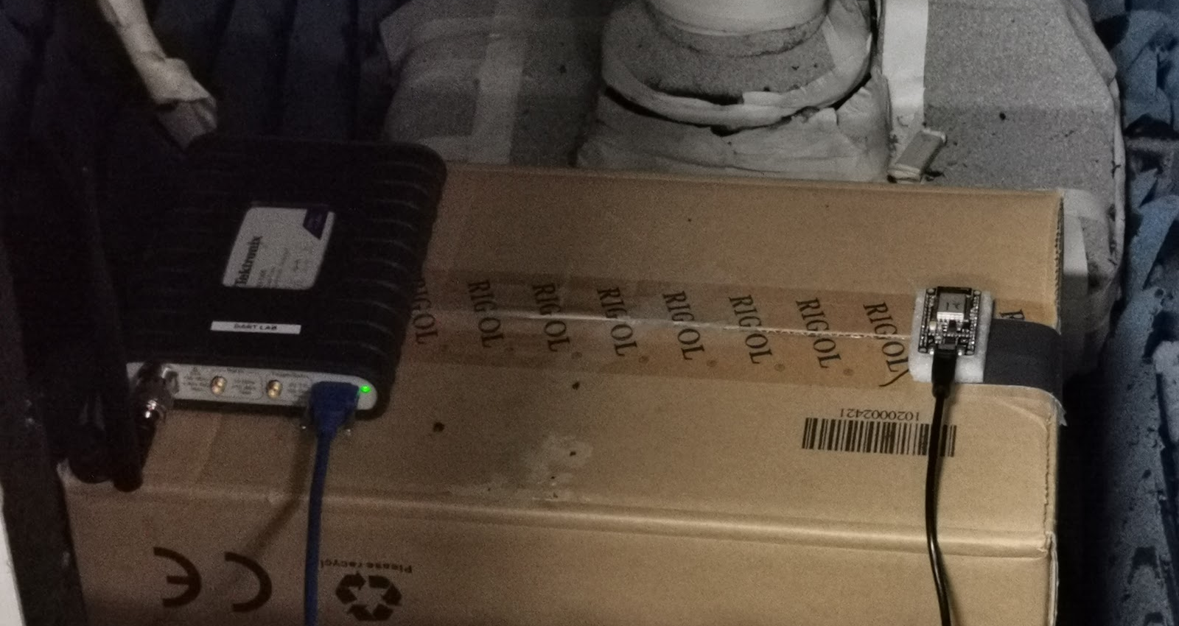
The Measurement
System is placed in a RF shielding chamber
The position of Transmitter and receiver is fixed.
The AC power and adapter of transmitter is fixed
Transmitters can be programmed with Arduino to change the beacon frame send, and the time interval between beacons
43 Different ESP12E Wi-Fi Module, Programable. Named from 1~43. Last 5(39~43) modules are both in mini5&43 dataset

Slide 5
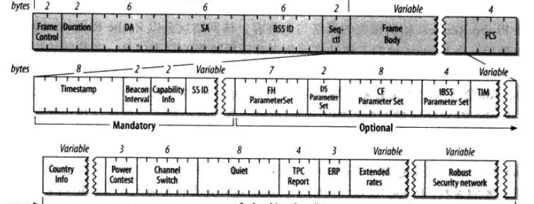
Program the Transmitter: Beacon Frame
The transmitter send out beacon frame showed above(which is defined in IEEE 802.11) periodically.
Attention, the SA and BSS ID is the MAC address of transmitter. The data sent by transmitter won’t the same if they were programmed to a fake and same mac address.

Slide 6
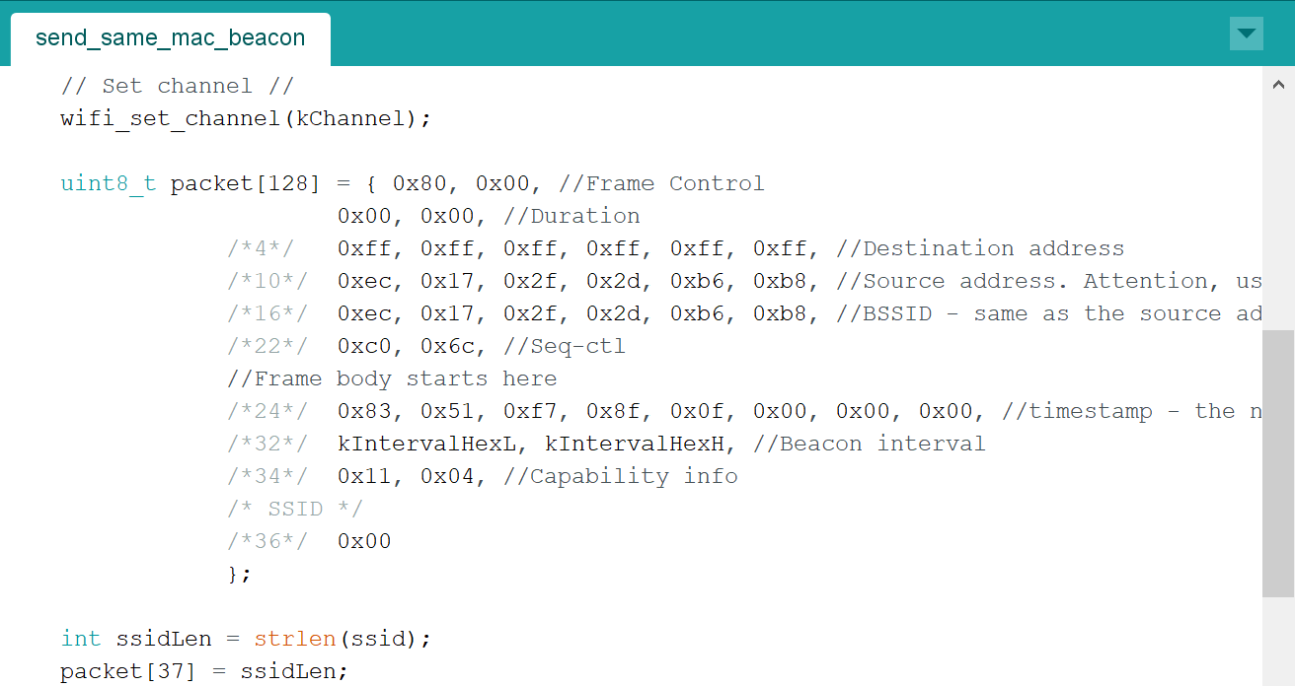
Program the Transmitter: Beacon Frame
This module can be programed to send designated beacon frame
We program the transmitter for 2 purpose:
All beacon frames send should have same SSID, SA and BSSID
We omitted the optional bytes and set the time interval between beacons to it’s minimum value for accelerate the data collection.

Slide 7
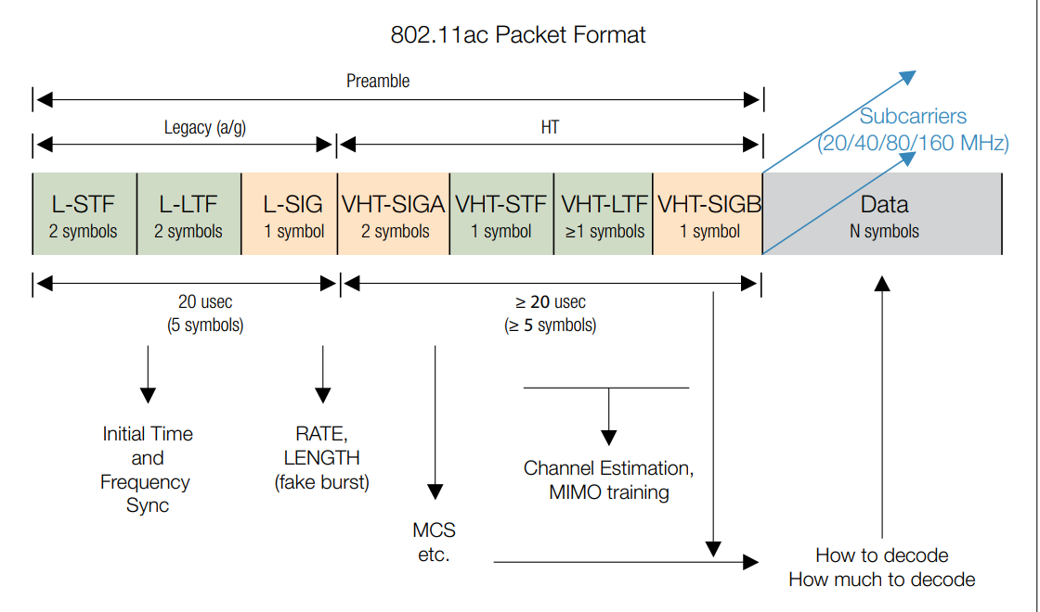
Program the Transmitter: Beacon Frame
However
The time stamp of beacon frame can’t be send manually, but it’s random in a sense
So the digital data in the frame we send is rather fixed or random.
The real digital signal sent to the air is encoded in packaged in a complex form, which I don’t have enough time to understand it.

Slide 8
Program the Transmitter: Beacon Frame
About Fake Mac Address
Theoretically, if we want model to learn analog only and ignore the digital information, each module should send random data, or at least random mac address.
For I'm kind of worrying the random data is little "hard" for our model, and we can't send totally random mac address(there is format demands) and it need time to read protocol. So finally we set each module's mac address same.

Slide 9
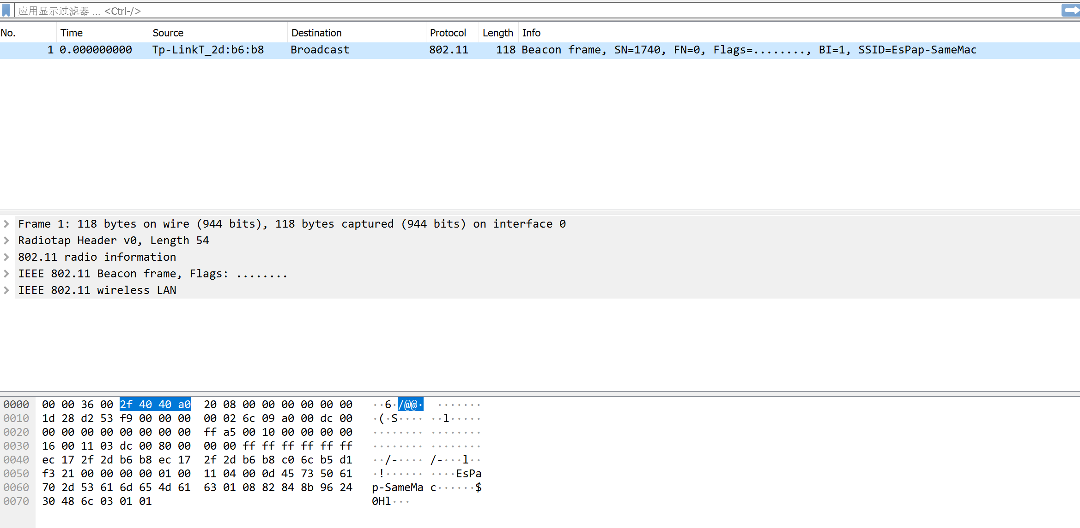
Program the Transmitter: Beacon Frame
By setting the linux version of wireshark into monitor mode, we can inspect every digital in the beacon frame we got and verify the transmitter program.

Slide 10
Setting of the Receiver
I forgot

Slide 11
CSV

Slide 12
Signal Sent
We set a very large receive points num to know what’s the whole signal look like.

Slide 13
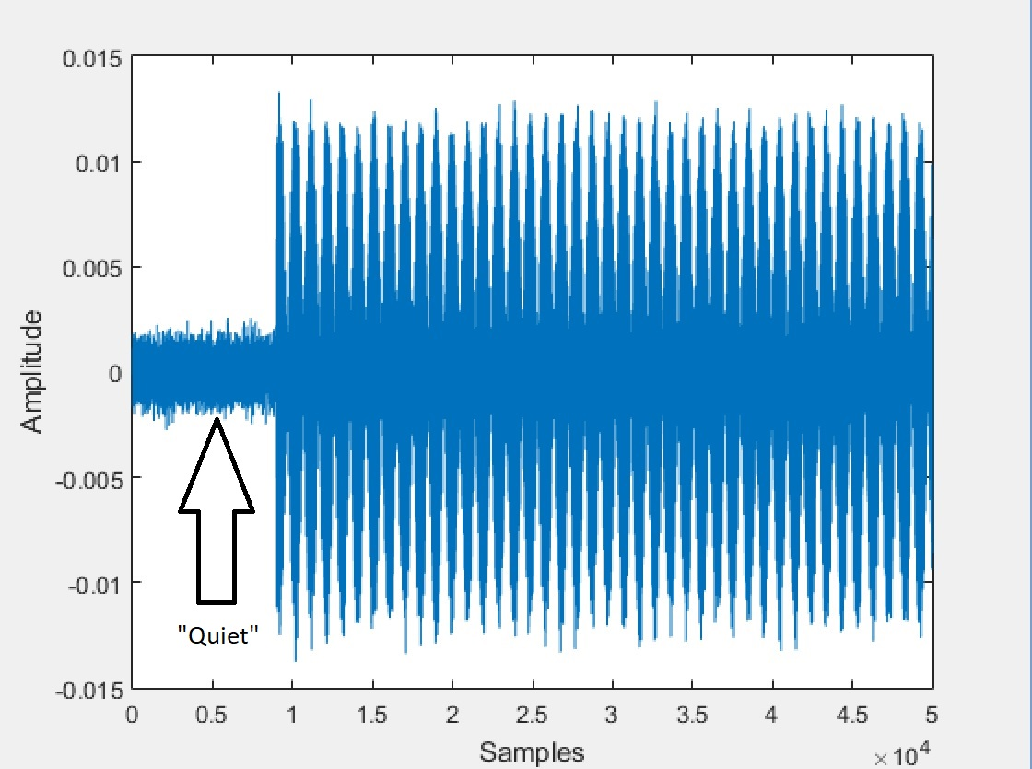
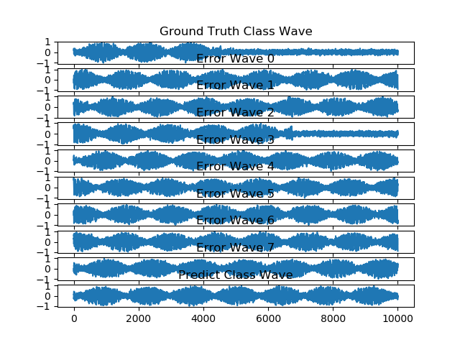
Signal we Received
We hope to receive a signal have a quite head,
just like last paper
That’s we really got. Now it seems the receiver is untriggered and retriggered during the beacon frame, so most of raw data don't have a quite head, some have a quite tail.

Slide 14
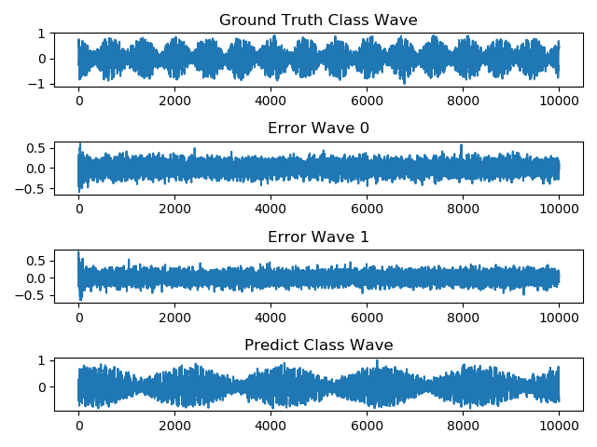
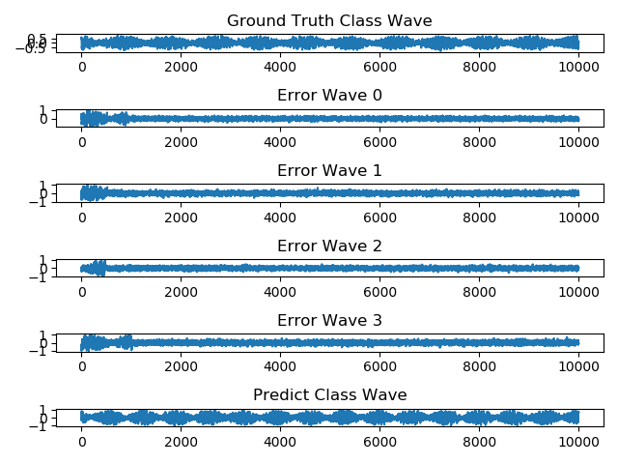
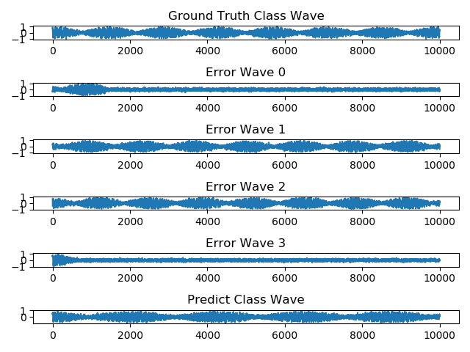
Influence of this "quite tail"
About half of error was caused by this “quite tail”
The signal we got can from any part of beacon frame, rather than the head part only.

Slide 15
Signal we Received
Possible Reason
We change the trigger threshold
Large Noise

Slide 16
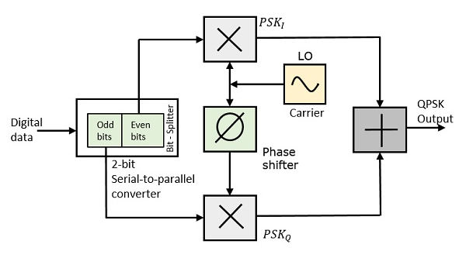
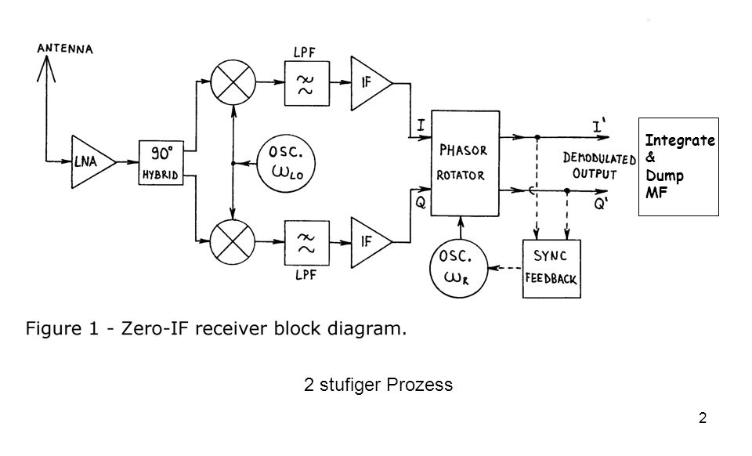
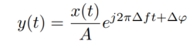
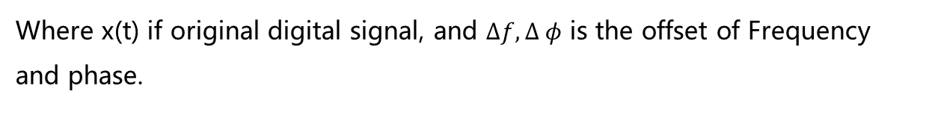
A Sketch of Whole System
channel
Where x(t) if original digital signal, and $Δf, Δ φ$ is the offset of Frequency and phase.

Slide 17
The Feature
We suppose the features are:
Frequency offset
Phase Offset
Phase diff between I&Q(If we use I&Q input)
Non-linear LNA
Attention: In some other paper I read, they aligned the I&Q, and current the Frequency and Phase offset.

Slide 18
Data we Collected
Collect Data of
diff_module_same_mac (mini5&43)[CSV]
same_module_diff_mac (mini5&43)[CSV]
diff_module_diff_mac(mini5&43)[CSV]

Slide 19

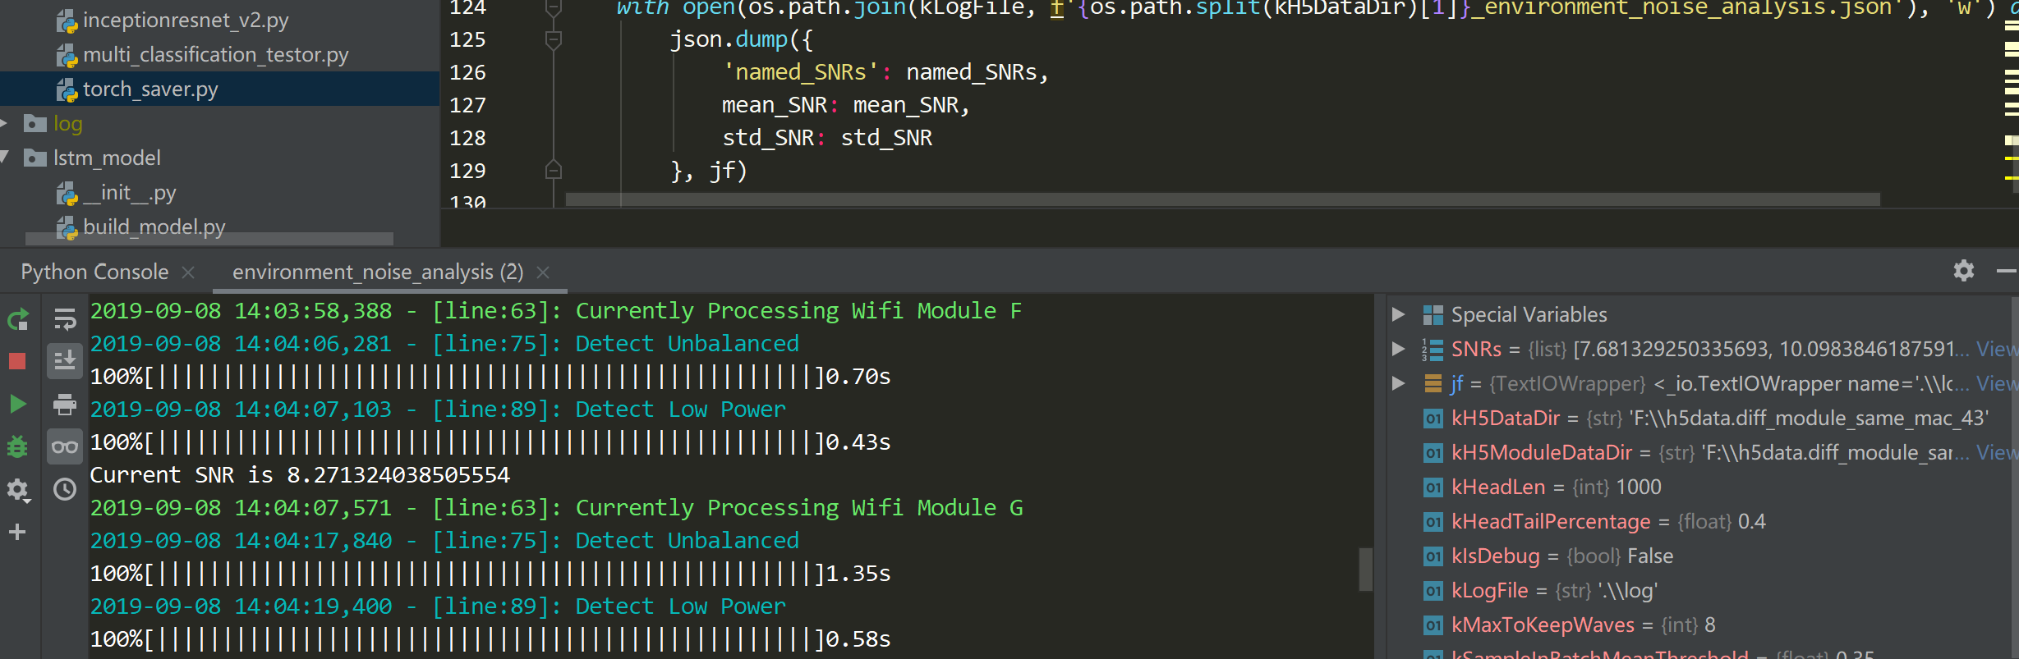
Data Cleaning

Slide 20
I&Q
Each sample have I&Q data.
If we only put I/Q data in model, then we will miss:
Digital information(We can’t decode it any longer)
Phase difference between I, Q
We are not sure which method, input I&Q or I/Q only is better, so we need to process both of them.
We will experiment each model with I/Q only input and I&Q input.

Slide 21
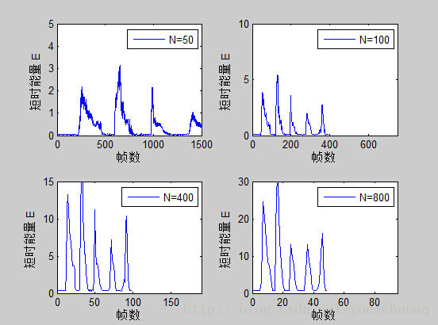
Data Cleaning: Trunk Quite Head
We use short time energy to trunk the quite head of the signal

Slide 22
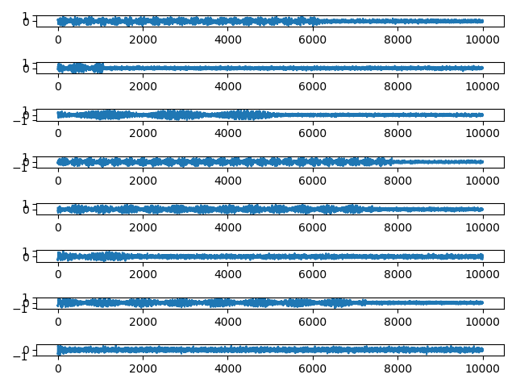
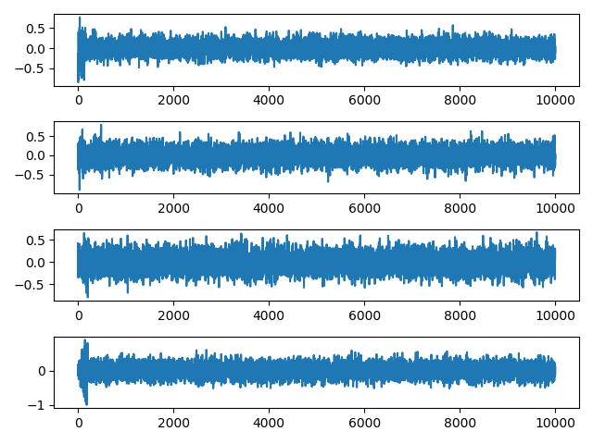
Data Cleaning: Discard the quite tail
Mean power is tow low(for long quite tail signal)
Power difference between first and last quarter is too large.

Slide 23
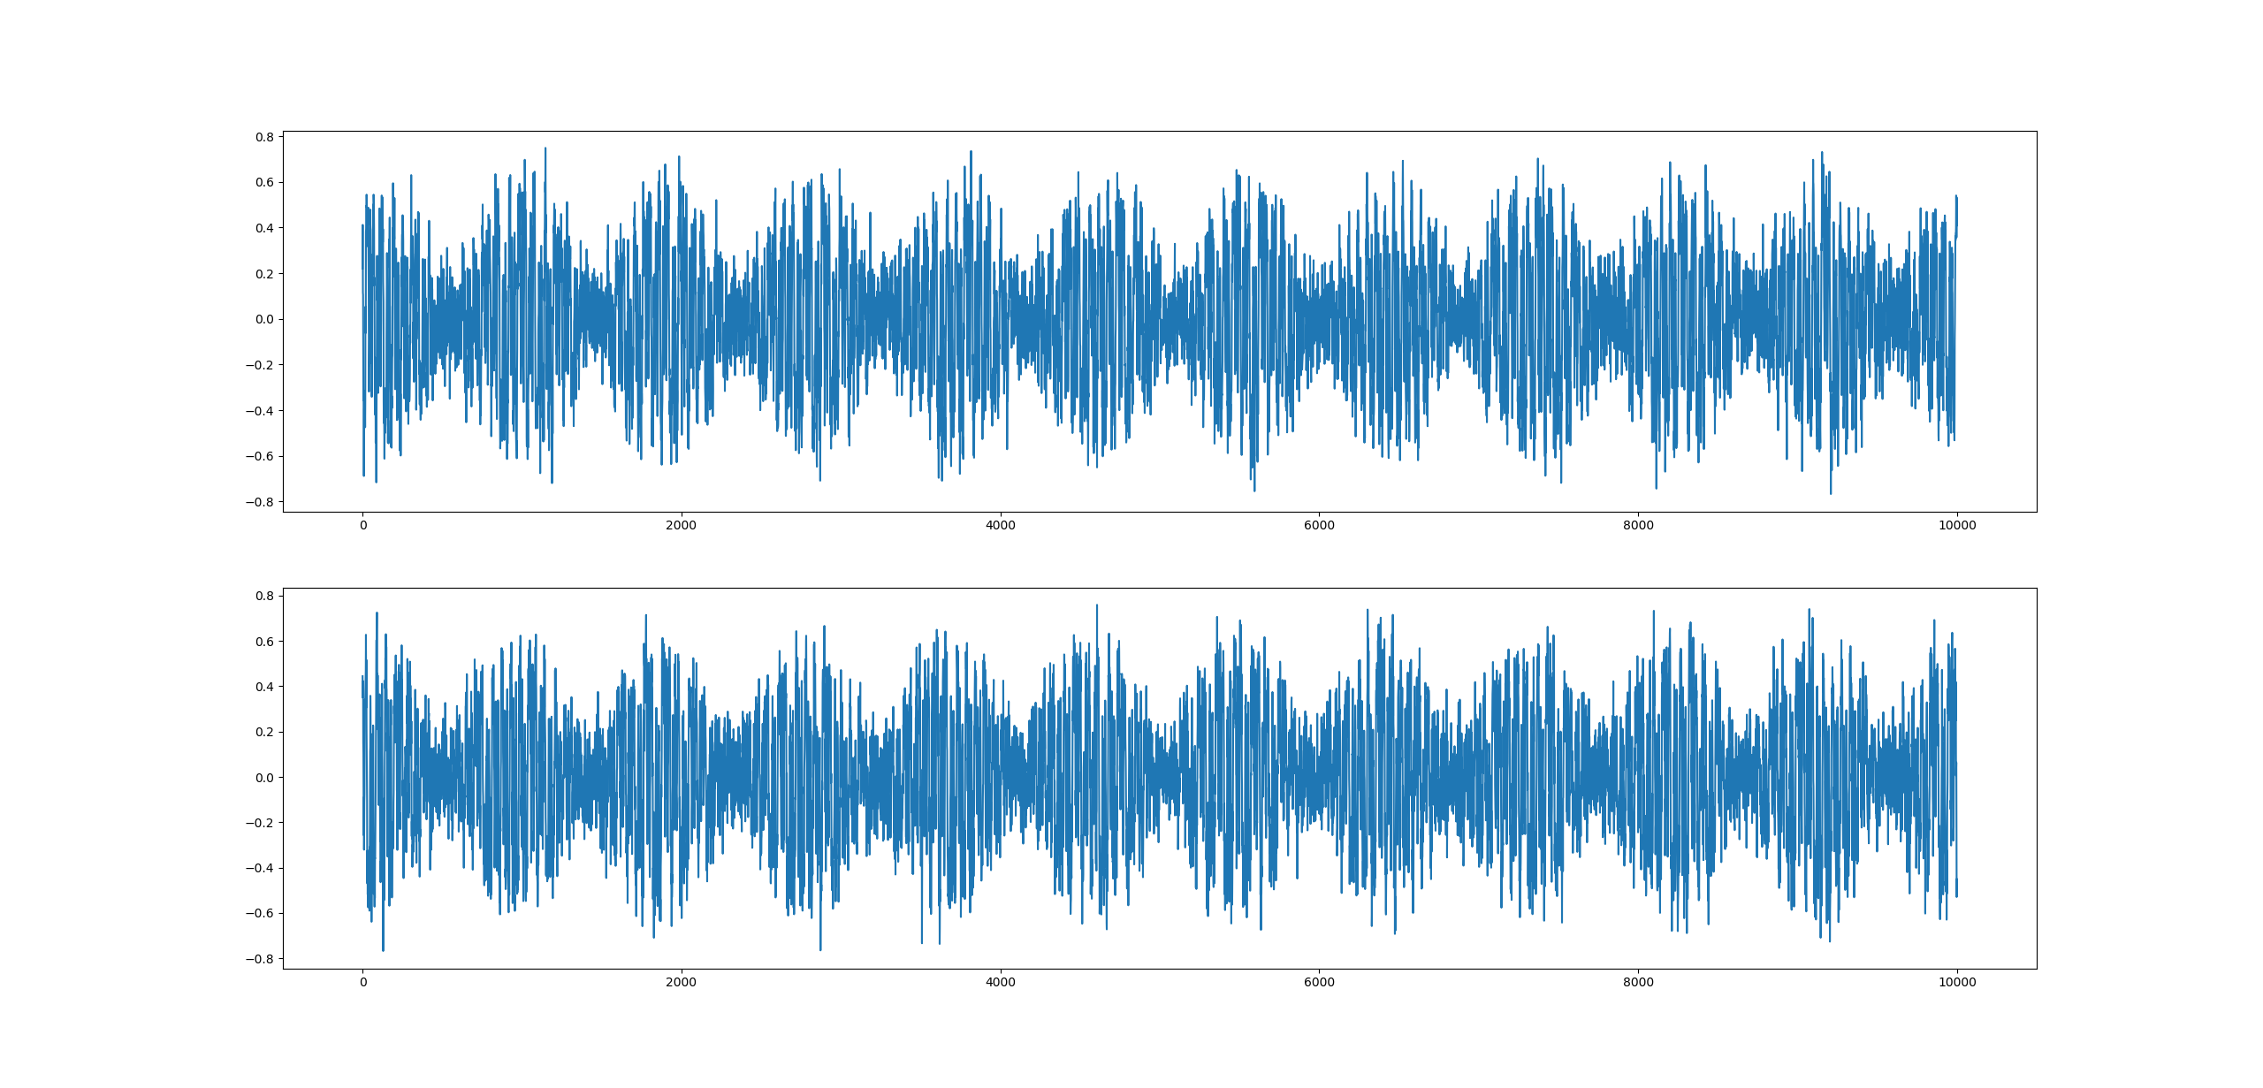
Data Cleaning: Normalization
We can normalize the data with Min-Max normalize or std normalize
Both of them can eliminate influence of distance change
We use Min-Max normalize. Which could make all point’s value < 1.0

Slide 24
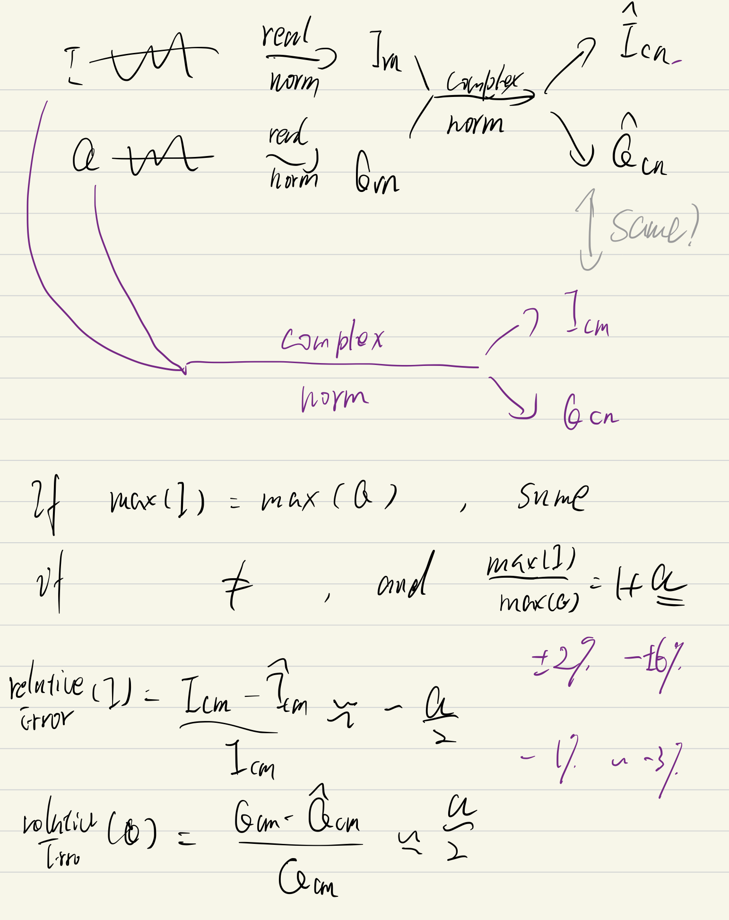
Data Cleaning: Normalization
It will be easier for training and sharing our dataset with pre-normalized samples
Normalize I/Q separately can be used for I or Q only training
Complex normalize I&Q can be used for training with I&Q input. However, this method will give out phase offset information when use I/Q only input.
Good thing is I proved that when I/Q’s max value is close, then first normalized separately, then use complex normalize is almost same to the result of use complex normalize at first.

Slide 25
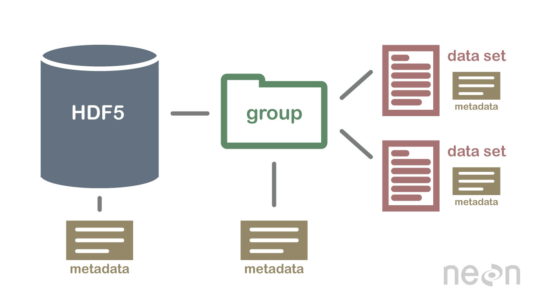
Data Packaging: Convert to HDF5
HDF5 is widely used in machine learning area. C, Matlab can also use it.
HDF5 is much more small than csv, while much more quicker when load and save the data.

Slide 26
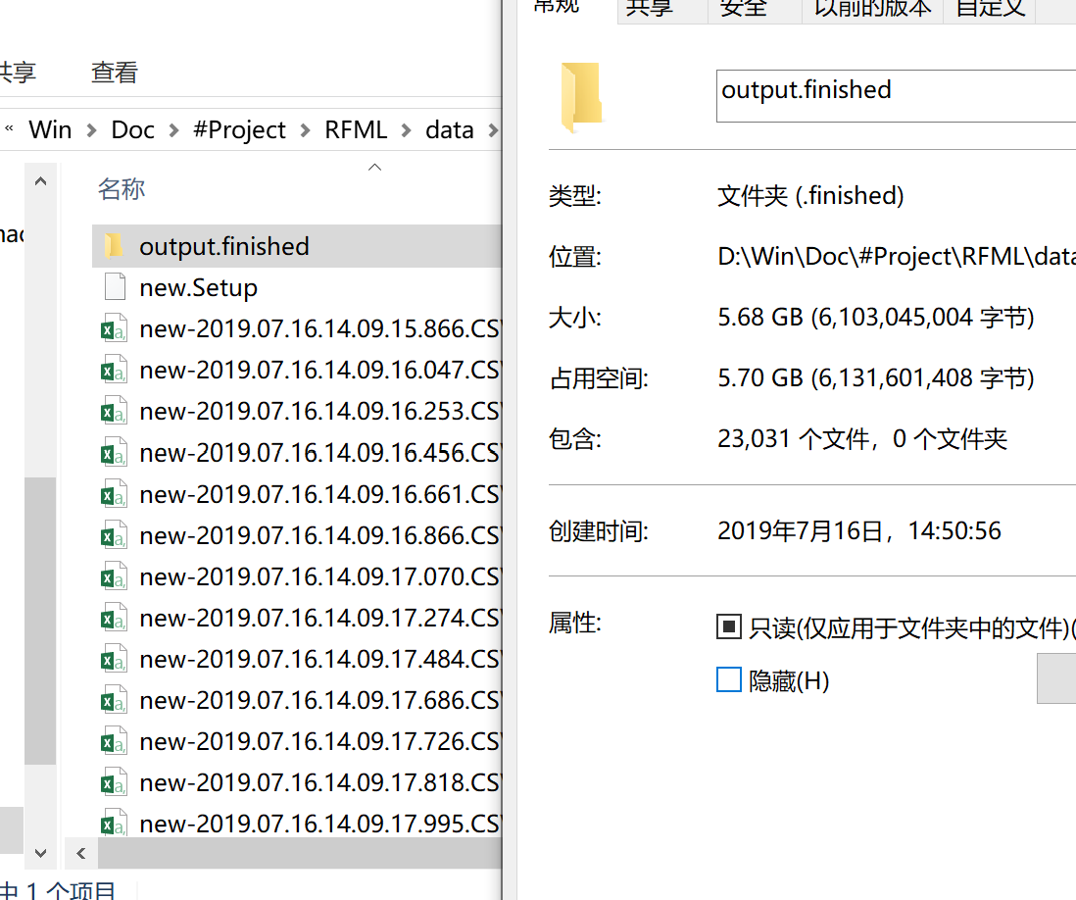
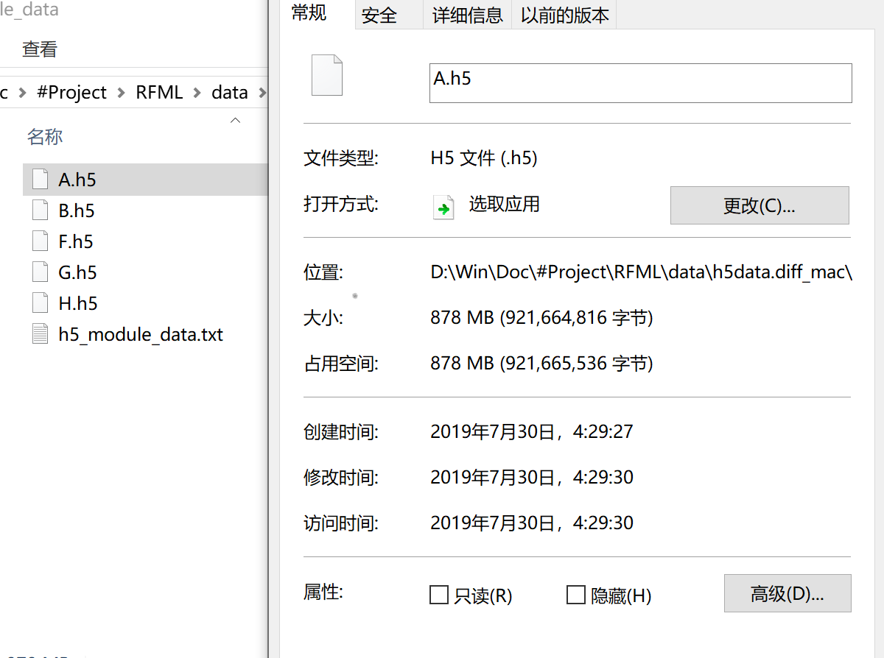
Convert csv ⇒ h5, use only 15% space

Slide 27
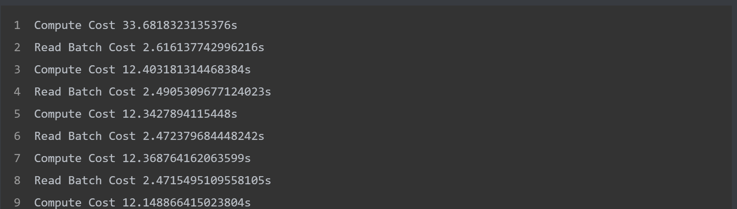
Much More better I/O Performance
HDF5 Only 15% time was cost on the reading data.
In another computer, one iteration cost about 55s~60s, which indicates that in csv/txt method, 75% of time was consumed on File I/O.
The old code load data from csv/txt, which cost a lot of time to read and convert string data to float32. Now we load data from h5 which data is in the right format and stored continuously, it's proved that this method is far more quicker than csv/txt method.

Slide 28
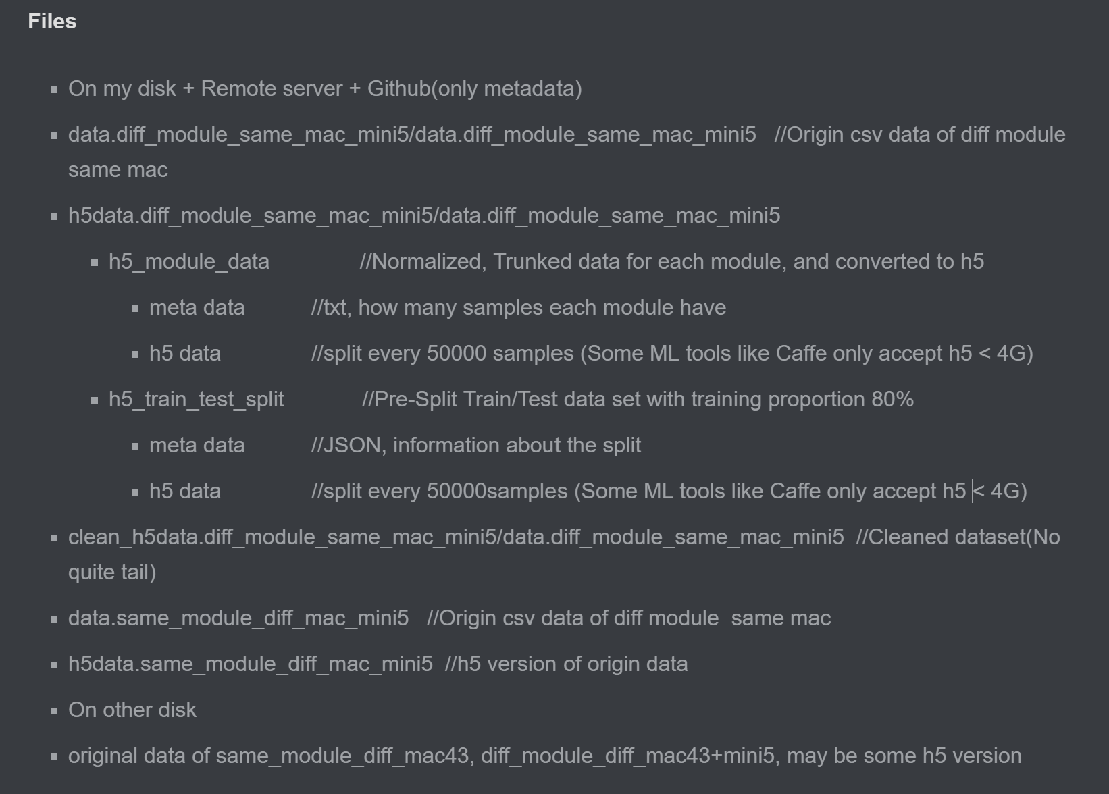
Files about Data
* On my disk + Remote server + Github(only metadata)
* data.diff_module_same_mac_mini5/data.diff_module_same_mac_mini5 //Origin csv data of diff module same mac
* h5data.diff_module_same_mac_mini5/data.diff_module_same_mac_mini5
* h5_module_data //Normalized, Trunked data for each module, and converted to h5
* meta data //txt, how many samples each module have
* h5 data //split every 50000 samples (Some ML tools like Caffe only accept h5 < 4G)
* h5_train_test_split //Pre-Split Train/Test data set with training proportion 80%
- meta data //JSON, information about the split
- h5 data //split every 50000samples (Some ML tools like Caffe only accept h5 < 4G)
clean_h5data.diff_module_same_mac_mini5/data.diff_module_same_mac_mini5 //Cleaned dataset(No quite tail)
* data.same_module_diff_mac_mini5 //Origin csv data of diff module same mac
* h5data.same_module_diff_mac_mini5 //h5 version of origin data
* On other disk
* original data of same_module_diff_mac43, diff_module_diff_mac43+mini5, may be some h5 version

Slide 29
Why Need Mini5 and 43 dataset
43 trained is the model we finally want to get.
MINI5's train and test is quicker, it can help us:
Decide is one model practical
Adjust the training parameter
The interactive error inspect program only works on local computer currently, and on mini5, the inspect may much more quicker and thoroughly(can inspect each misclassifying situation).

Slide 30
Others
Data Augmentation
We are not clear about the feature, and out dataset is very huge, so no augmentation needed
Pre-split Train/Test dataset
We pre split the dataset for train/test for variable controlling
Distribution
In our pre-split train/test set, the class is balanced.

Slide 31
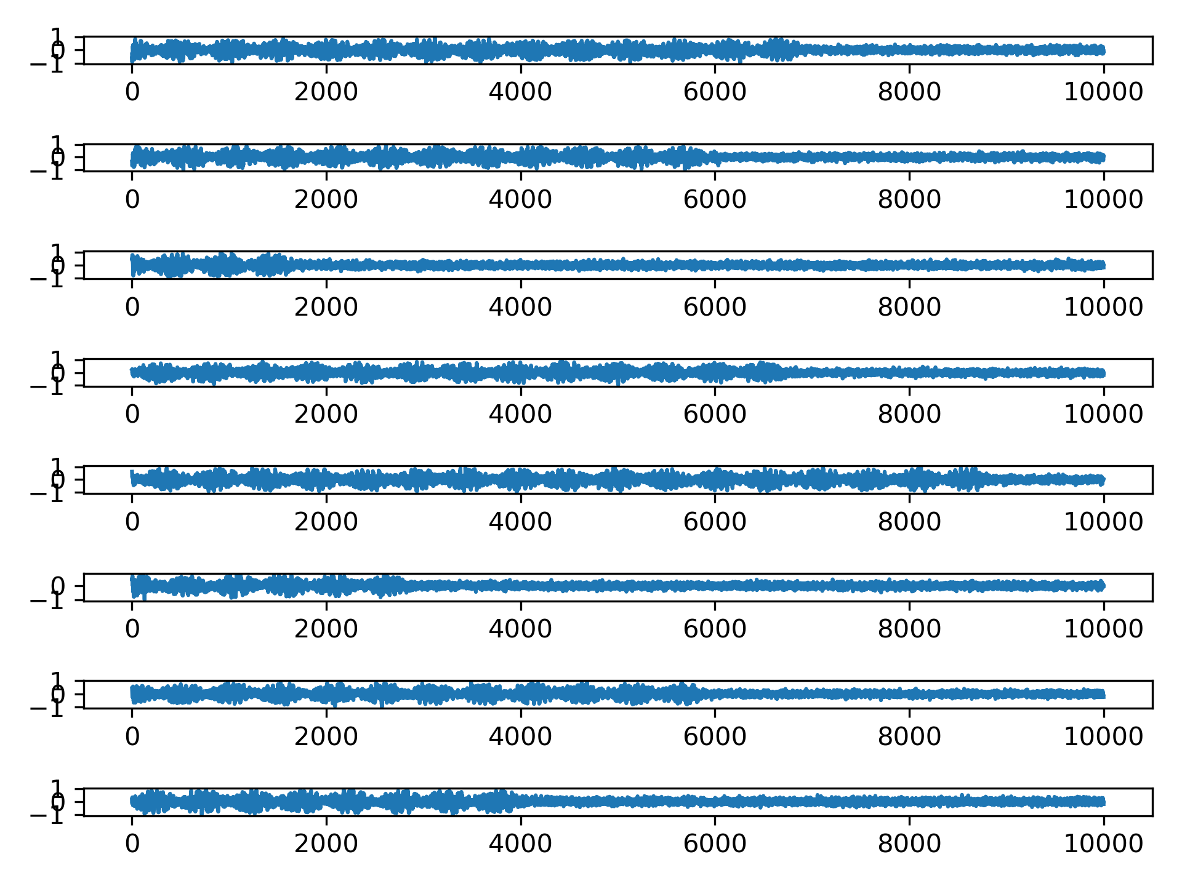
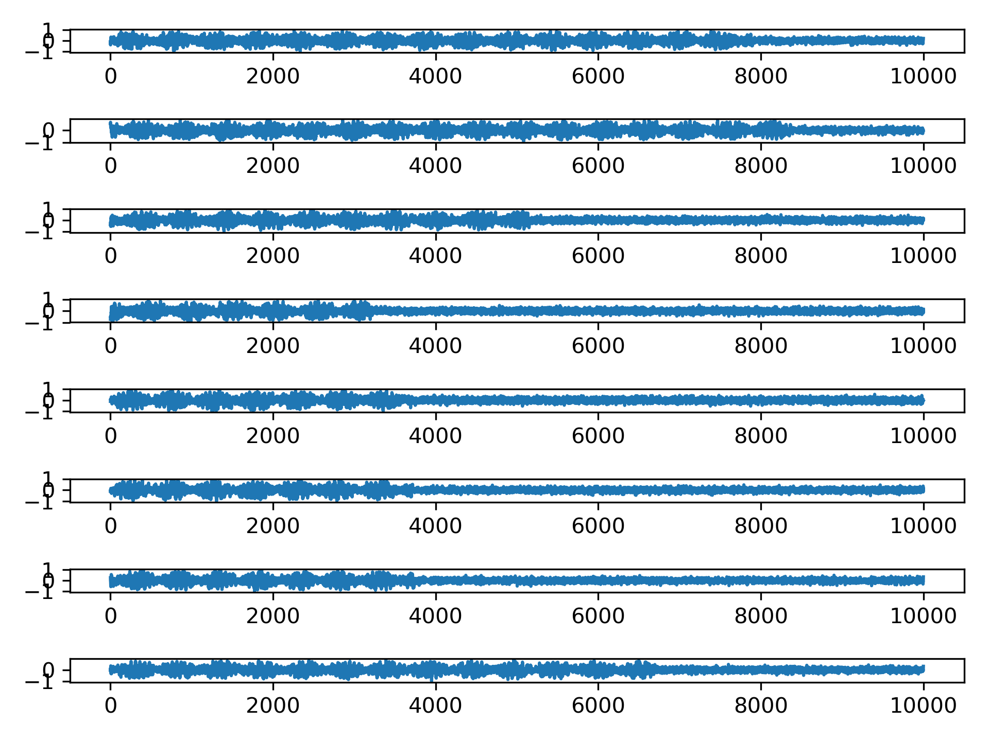
Noise Analysis
We can use unbalanced samples' quiet tail to estimate the power of signal and noise, then to calculate the SRN
Unbalanced Q
Unbalanced I

Slide 32
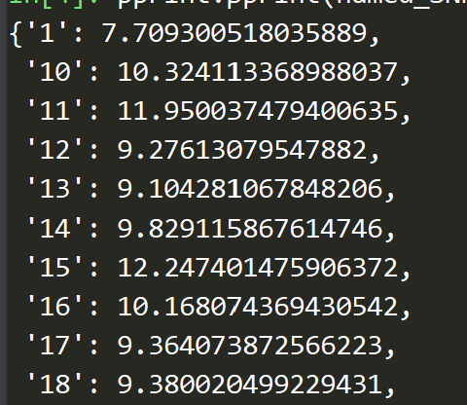
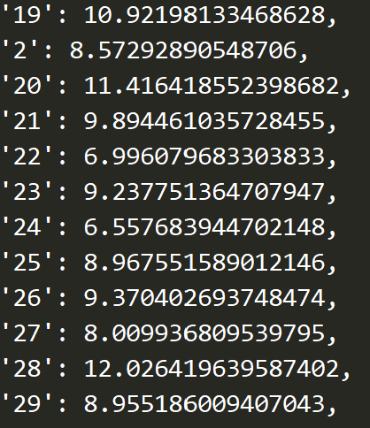
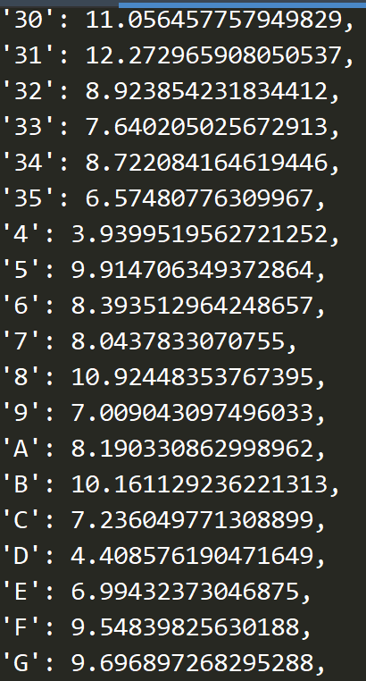
Noise Analysis
Here are the SNRs estimate for each class(Wi-Fi module)

Slide 33
Noise Analysis
The noise is too HIGH!
The paper I read before, they said their environment SNR is 30db. And they didn’t use a RF Shield

Slide 34


Models

Slide 35
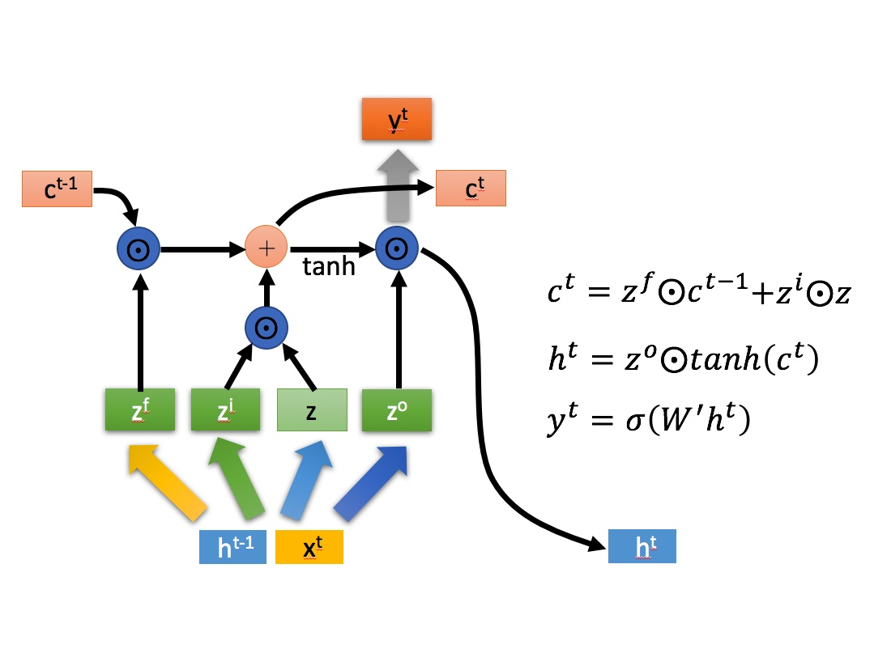
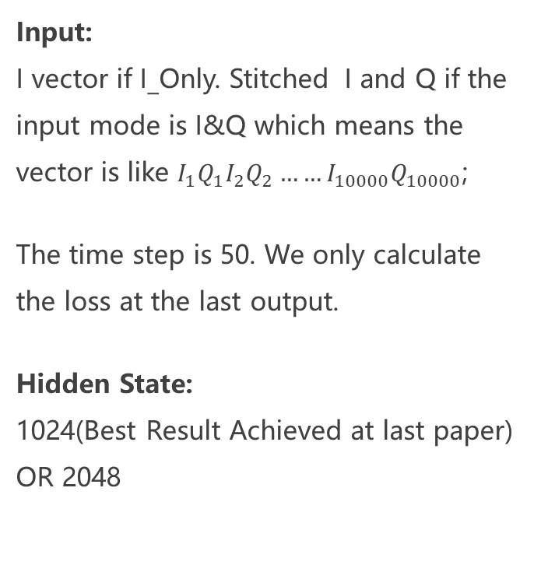
Baseline: LSTM
Input: I vector if I_Only. Stitched I and Q if the input mode is I&Q which means the vector is like $I_{1}Q_{1}I_{2}Q_{2}……I_{10000}Q_{10000}$;
The time step is 50. We only calculate the loss at the last output.
Hidden State: 1024(Best Result Achieved at last paper) OR 2048

Slide 36
Baseline: LSTM
Input: I vector if I_Only. Stitched I and Q if the input mode is I&Q which means the vector is like $I_{1}Q_{1}I_{2}Q_{2}……I_{10000}Q_{10000}$;
The time step is 50. We only calculate the loss at the last output.
Hidden State: 1024(Best Result Achieved at last paper) OR 2048

Slide 37
1D-DCNN
How to use an 2-D DCNN
We can use some frequent-time analysis method, like CWT or WVD to convert the signal to an 2-D input.
Though it seems more nature to use 2-D input, for most CNN is designed for 2-D input. However, we use an 1-D DCNN finally.
Why use 1-D DCNN
The DCNN is supposed to be an end-to-end model, so we try to avoid pre/post process.
We find the 2-D input will be way too large for an modern DCNN.

Slide 38
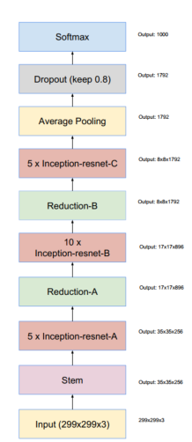
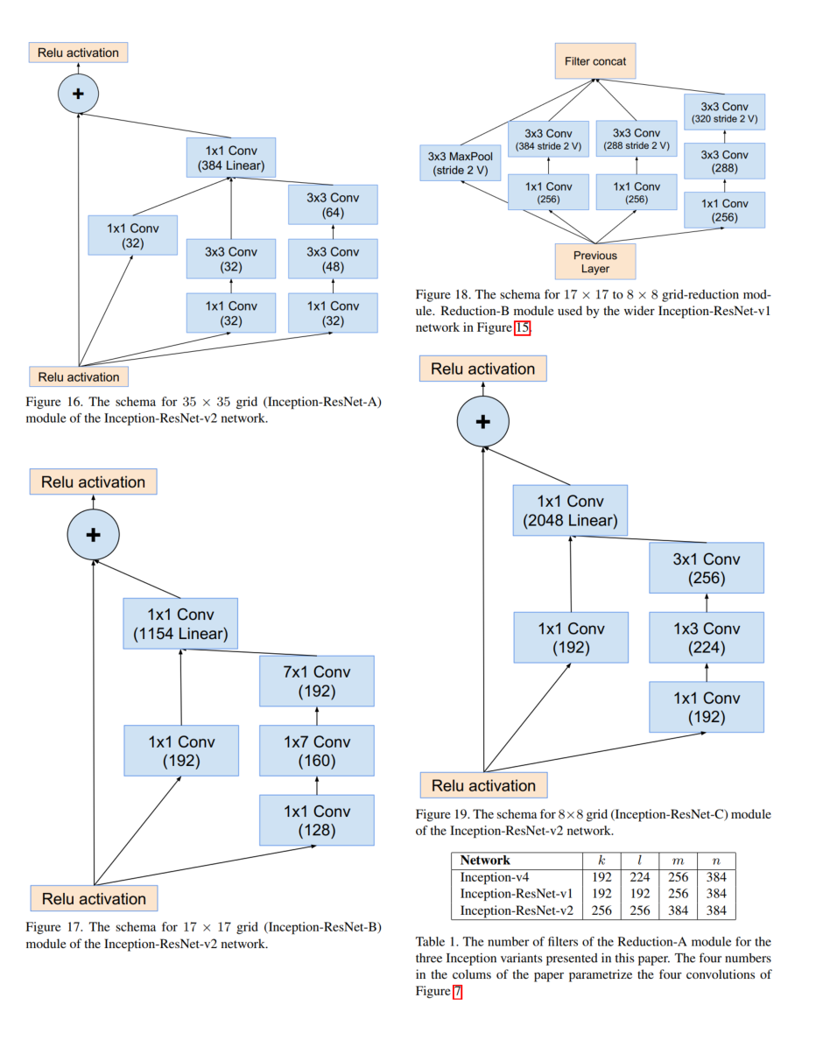
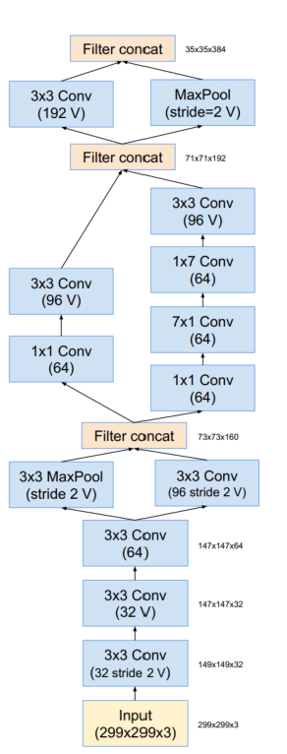
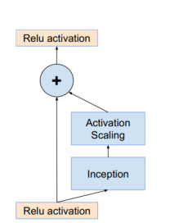
Modify InceptionResNet to 1D
Why Inception?
The inception net have a large variance of receptive fields, which can extract features from different scales.
“Inception” can make very efficient compute
Why Resnet?
We can change the size of the model easily by changing the block num.
Resnet can inhibition the gradient disappear and training degradation

Slide 39
How to Modify
Fist, we set all operator from 2-D to 1-D
The input size of 1-D is smaller than 2-D input. However, the speed of the size shrinking of 1-D DCNN is also smaller than 2-D DCNN.
We hope the 1-D InceptionResNet’s computation consumption is close or less than 2-D InceptionResNet, which is already kind of too big for common GPU. So we calculate the computation consumption of each layer of 1-D and 2-D DCNN.
When 1-D DCNN’s computation consumption is large than 2-D’s, we add an additional down sample layer to 1-D DCNN, to keep their FLOPs close finally.

Slide 40
Others
Model Size
LSTM: 5M
InceptionResnet: V2 60M V1 30M
FLOPs
Not Calculated yet
I will update these figure after I finish the model analysis program.
Loss Function
We use Cross Entropy as loss function

Slide 41
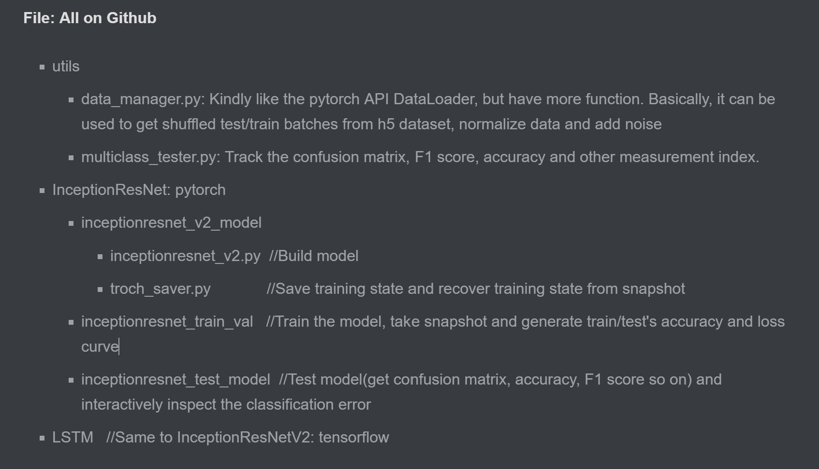
Code Files

Slide 42

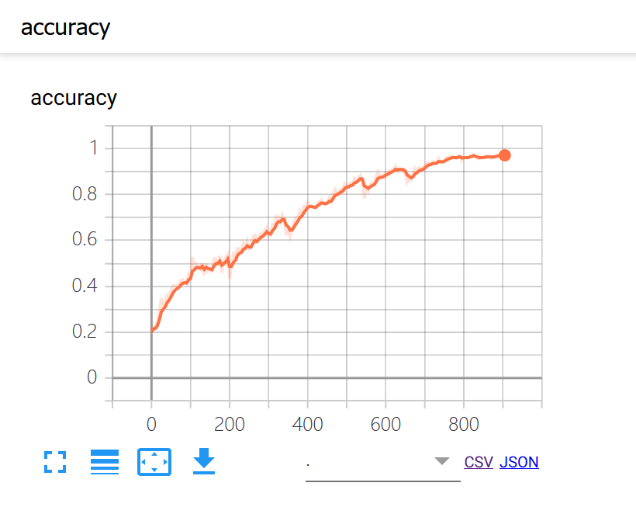
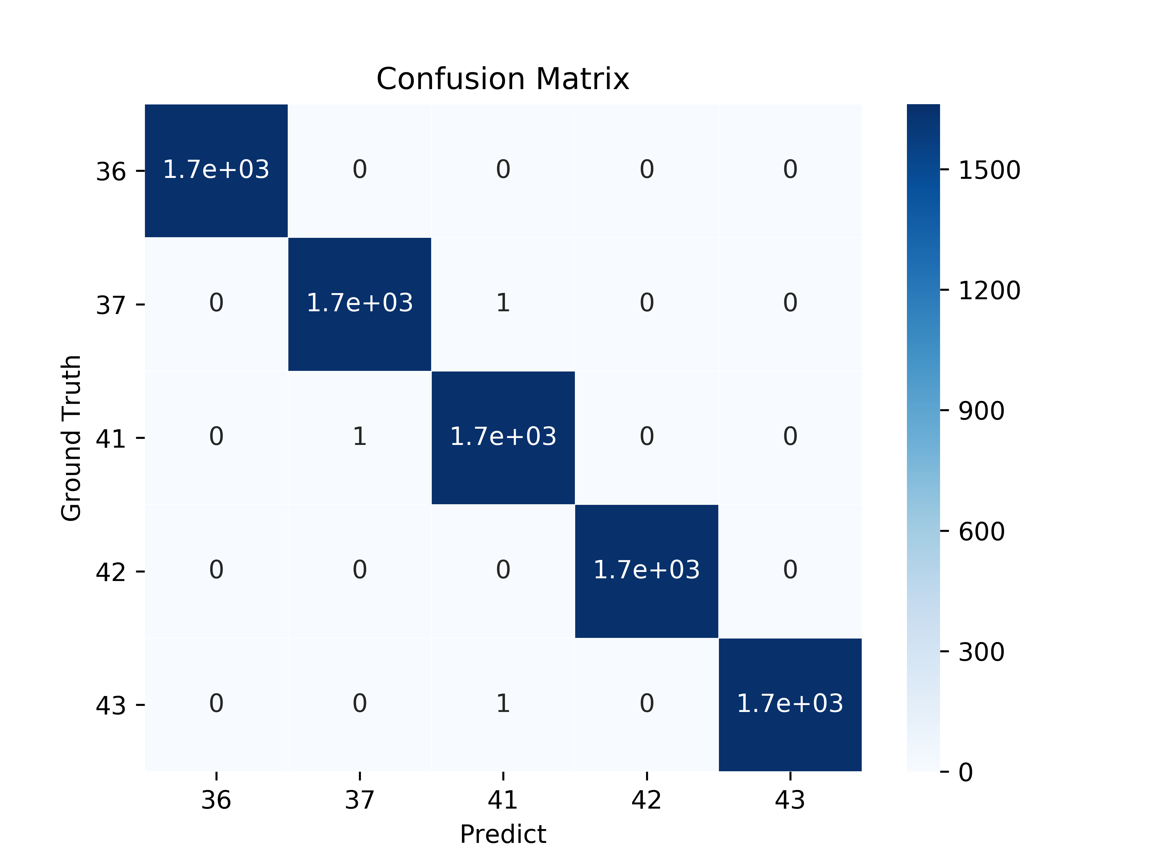
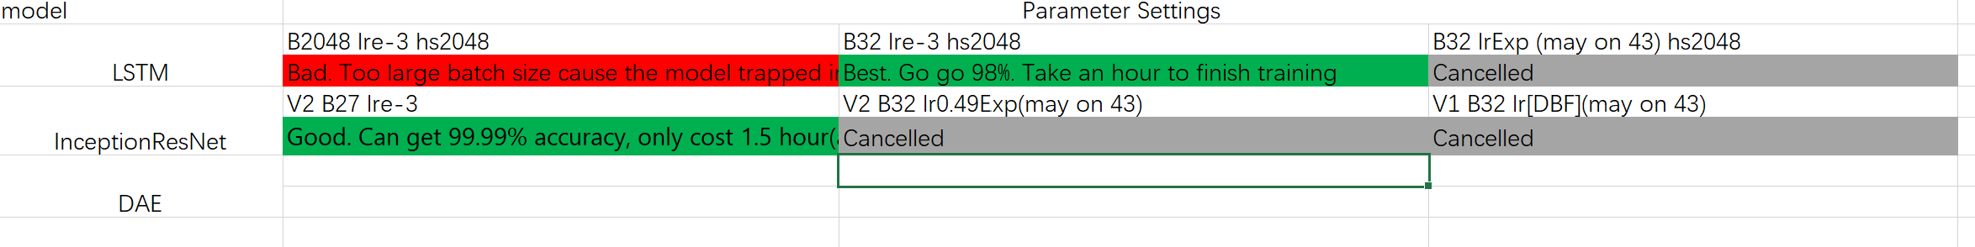
Experiment

Slide 43
Hardware & Software
Hardware
1 Tesla K80 GPU on Google Cloud Plate form
Software
LSTM: TensorFlow
InceptionResnet-1D: Pytorch

Slide 44
Training Param
Optimizer
Adam, default
Adam, default except Decaying Learning Rate
Batch Size
LSTM: 32 vs 1024
InceptionResnet-1D: 27

Slide 45
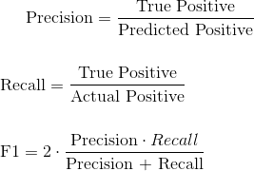
Metric
We use Precision(micro/macro average) and F1 Score to measure model’s performance.
Most of time, they are very close.

Slide 46
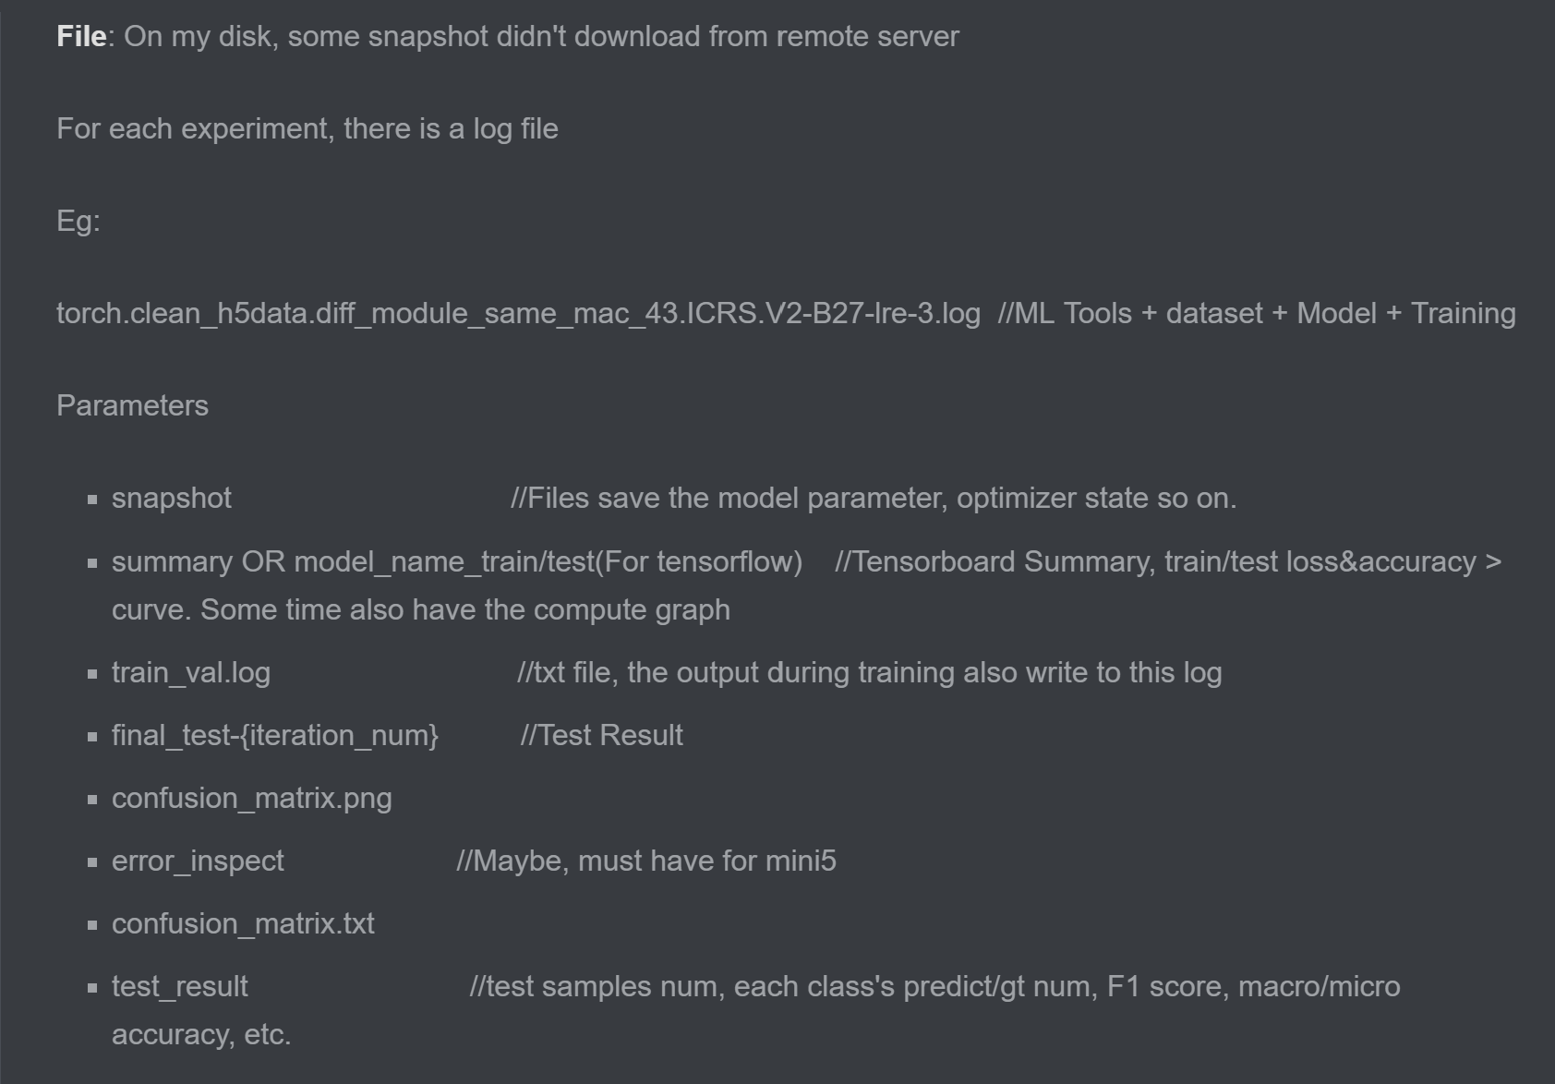
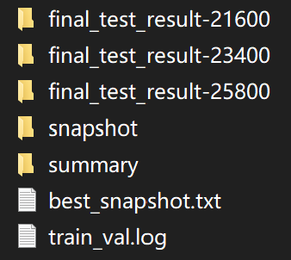
Experiment Record

Slide 47
Experiment Record: Snapshot
We provide the pre-trained model with best performance.
We called it snapshot because the program save the model periodically and we can restore the training with this snapshot.
The number in the file name is its corresponding training iteration

Slide 48
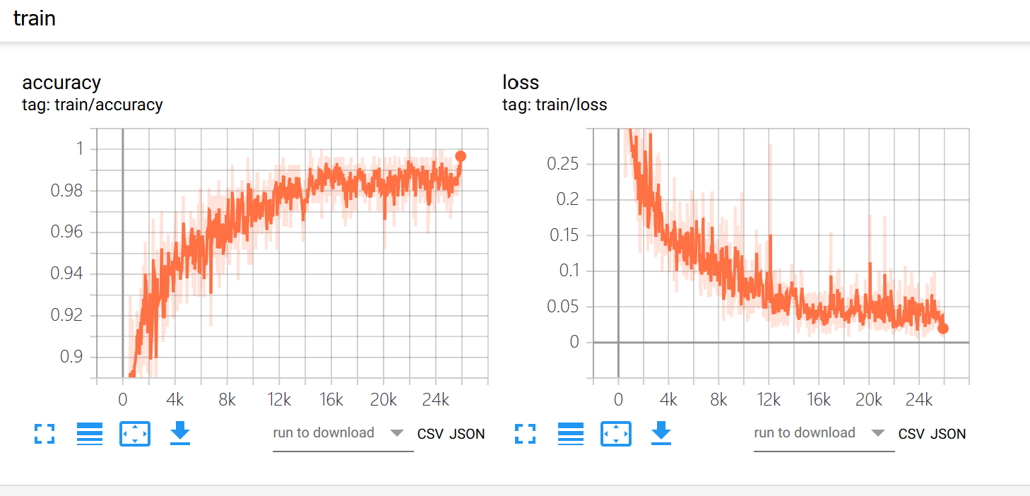
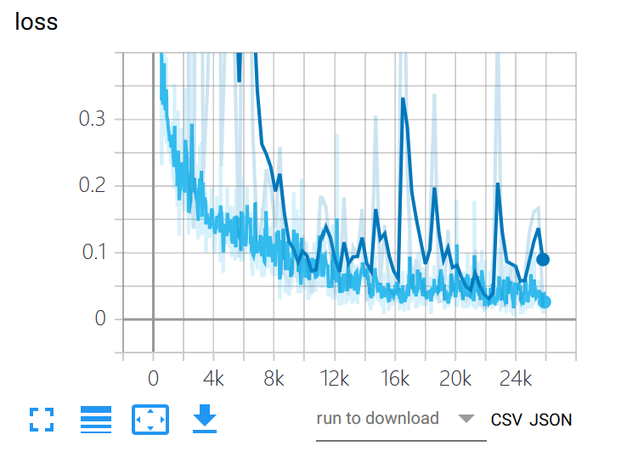
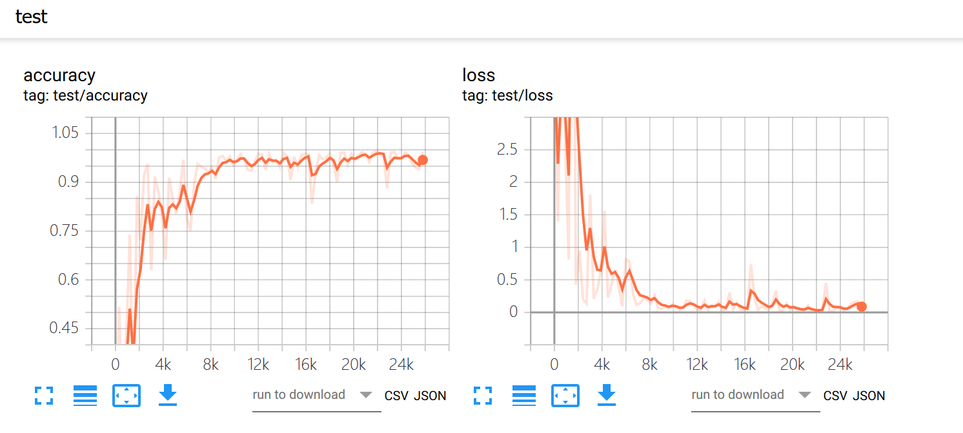
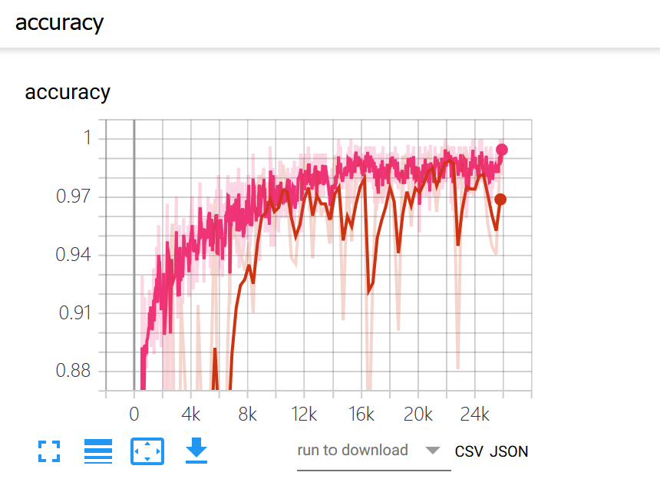
Experiment Record: Summary
We keep a record of train/test accuracy/loss over the whole training procedure.

Slide 49
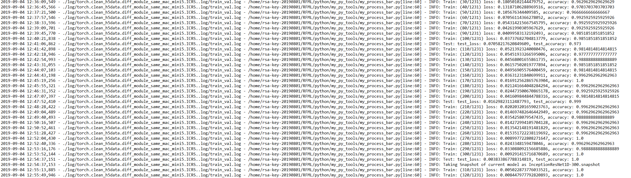
Experiment Record: Log
We keep a very vivid train log

Slide 50
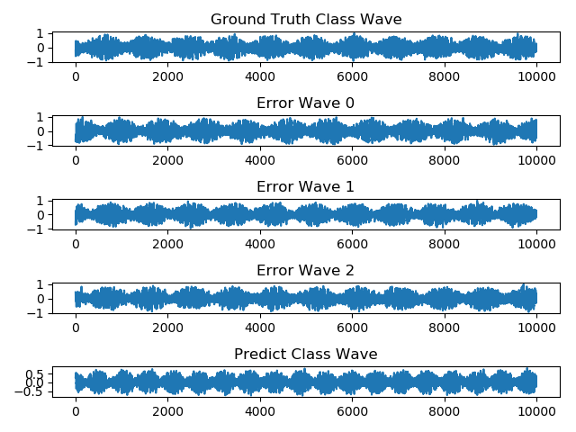

Experiment Record: Error Inspect(For Mini5)
Error Inspect gives samples that was misclassified, comparing to it’s ground truth class and prediction class.

Slide 51

Experiment Record: Confusion Matrix
txt and png confusion matrix

Slide 52

Experiment Record: Test Result
Test Result:
Contains almost every thing you can calculated from confusion matrix

Slide 53

Final Test Result
On Mini5, 3 Experiments, with vivid record
On 43, 7 Experiments, with vivid record
See More clearly on Github’s experiment plan

Slide 54

Principle
Always Double Check
Always Record

Slide 55
Always Double Check
Use wireshark to verify the Arduino program
Manual verify normalize program by excel
visualize the trunk and discard
visualize the misclassified sample
Manual estimate the noise by excel, visualize the noise add program. Write an program to test the complex noise add program
visualize the model

Slide 56
Always Record
We have all kind of data: raw, processed, csv, txt, hdf5
We have all code needed on Github
We have all trained model on Google Drive
We have all experiment plan and result on Google Drive

Slide 57
Add Noise
Discuss how to add noise

Slide 58

Thank You
RFML
https://github.com/HAL-42/RFML

